Slide 1
Ansible 101
cpaggen – November 2017 – v1.1

Slide 2
What’s this deck about?
You heard about Ansible, but you don’t really know what it is or how it works
What we’re going to cover:
Ansible 101 – what it is, how it works, how to install
Crash-course on Vagrant + VirtualBox
Keyless SSH and password-less sudo
Ad-hoc commands
Playbooks
Roles
Modules
ACI integration
At the end of this deck, you’ll be in a good position to start automating many tasks

Slide 3
Disclaimer
Ansible can do so many things and ships with so many options that covering them all would make this deck cross the 1000-slides boundary
That’s not the intention of this deck - it’s meant to get you up and running in half a day or so and automate frequent repetitive tasks
If you’re interested in going quite deeper:
Practice, practice, practice and read the docs
Explore playbooks on Ansible Galaxy, their community website
Enroll in a professional cours that teaches Ansible over the span of several days
In this deck, we take several security shortcuts that wouldn’t be considered particularly safe for production environments
Don’t take these shortcuts as best practices – they’re convenient for lab use and learning

Slide 4
Ansible 101 – the basics
Open-source configuration management, deployment and orchestration tool
Declarative (when possible) and idempotent (see next slides)
Can manage a wide range of systems: VMs, network devices, cloud instances, etc.
Server-side component only: no agents on target systems
Strict push model (contrast with Puppet or Chef for example)
All orchestration instructions are text-based and human-readable
Uses SSH to communicate with target systems
For Windows-based platforms, uses pywinrm (note: the Ansible server is *always* Linux)
Root/admin access is not required (Ansible can sudo when necessary)
Two modes:
Ad-hoc commands (i.e. execute a command to 50 target systems once)
Playbooks: apply specific roles to target systems

Slide 5
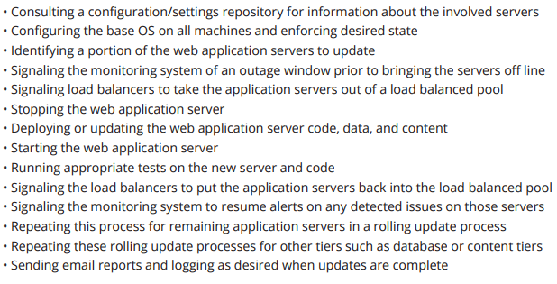
What can I do with Ansible?
Examples from the documentation:
Long story short: pretty much everything you do manually in the DC

Slide 6

Ansible – high-level architecture
Targets
Inventory
Inventory: target systems for automation
Playbook: a series of plays (automation tasks)
Modules: accomplish specific tasks in Ansible (e.g. install packages, configure ACI, etc.)
Ansible Config: determines how your Ansible setup behaves (how many concurrent connections, etc.)
Playbook
Ansible Config
Python
SSH
Modules

Slide 7
Ansible 101
Text-based hosts file lists all possible targets (the inventory)
Targets can be grouped arbitrarily (i.e. [all-web-servers]; [all-non-prod], etc.)
Playbooks contain instructions (called ‘plays’) that execute on targets
E.g.: “install mariadb, patch a config file, restart mariadb” on [sql-servers]
Playbooks can be structured to apply specific roles to targets
Each role then gets its own directory structure and its own plays (in main/tasks.yml)
Ansible supports templating
Plays can use variable substitution (i.e. {{ global-proxy }} is replaced by whatever value global-proxy is given in a variable file)
Ansible is extensible via modules (450+)
Ansible Galaxy is where the community contributes playbooks and modules

Slide 8
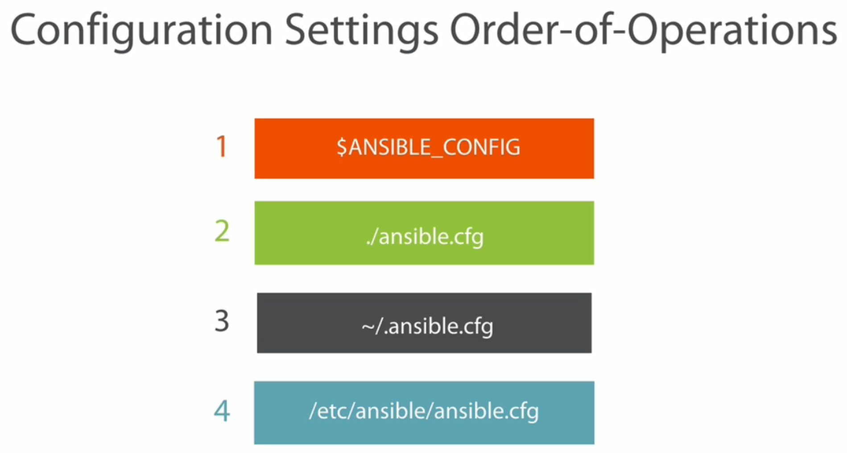
Ansible configuration: which one gets used?

Slide 9
SSH, Python .. What gives?
Ansible expects remote systems to have /usr/bin/python version 2.6 available
Most Ansible modules are written in Python
What’s a module? If you ask Ansible to run a Shell command, you use the shell module
If you ask Ansible to configure ACI, you use the ACI module
These modules receive parameters based on your playbooks
Ansible then pushes those customized Python scripts to remote systems over SSH
Python scripts then execute on those remote systems
It’s possible for Python scripts running on remote systems to fetch content via say a REST API, or any other means – it all depends on the module

Slide 10
Ad-hoc commands and playbooks
Ansible offers two modes of execution:
One is called ad-hoc commands
The other is called playbooks
Ad-hoc commands are a great way to get familiar with Ansible
They’re commands you run once
They typically contain one thing you’d like to see performed on remote systems
E.g.: install a package on all VMs in group “Dev-Web”, or stop a service, replace a file, reboot systems, copy a local file to remote systems, etc.
On the other hand, playbooks are YAML files that contain plays
Plays contain a series of tasks you’d like to perform on your inventory items

Slide 11
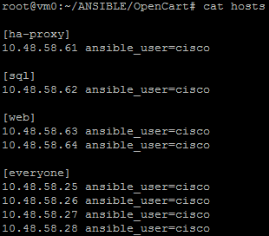
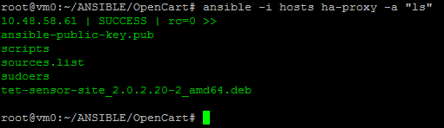
Ansible 101: inventory and ad-hoc commands
Here’s an actual inventory file with four groups of targets
Running an ad-hoc command against a group is as simple as this:
If you don’t use the –i option when running Ansible, hosts are specified in /etc/ansible/hosts. When using the –i flag, Ansible can use a local inventory file.
We could easily reboot all servers labeled [everyone] for instance. Ad-hoc commands are very useful! The ‘command’ module is used by default, you provide args using the –a flag.

Slide 12
What just happened?
We told Ansible to run the “ls” command against systems part of the ha-proxy group
This is called an ad-hoc command, it doesn’t contain a detailed sequence of steps (called plays) – just something to do and then bail out
By default, an Ansible ad-hoc command runs the “command” module
Allows you to execute shell commands inside a Python script on the remote system
We’ll see later that there’s also a “shell” module
This one runs commands inside a proper shell on the remote system, allowing you to use shell variables

Slide 13
Remember the Python and SSH slide?
When you run an Ansible automation sequence against a remote system, the Ansible server locates a Python script (in available modules) that does what you’re asking for
The basic syntax for an Ansible ad-hoc command is ansible <system> -i <inventoryFile> -m <module> -u <username> -k <password prompt>
When you run such a command, the Ansible server actually pushes that script to the remote system using SSH and executes that script on the remote system
Example:
This means remote systems must have Python installed

Slide 14
Local Ansible
OK, so Ansible pushes Python scripts to target systems using SSH
What about systems offering robust REST APIs for instance? Wouldn’t that be better than SSH?
It could be, but that’s not exactly how Ansible works
Ansible can have Python run on the target system to fetch REST API content
That’s referred to as local Ansible. The ACI modules use this model for example.

Slide 15
Ansible Inventory

Slide 16
A bit more info about the inventory
The inventory file usually adheres to the INI format, but YAML is also acceptable
The INI format is simple
You group targets using [..] and list targets by hostname or IP address under the group’s name.
Inventory items (remote systems) can take optional variables
It’s quite common to see ansible_user=<user> next to a target
This specifies which SSH user should initiate the SSH connection
Depending on which user generated the key pair and which user is executing Ansible playbooks, you may or may not need to specify ansible_user=<user>
There are two reserved group names: [all] and [ungrouped]
You can append any arbitrary variable to your hosts, and have Ansible perform variable substitution for each host (more later)

Slide 17
Basic inventories
You can group hosts by categories, and assign variables to hosts or groups
Systems can be in multiple groups
[web]
192.168.30.10 ansible_ssh_user=cisco
[web-secure]
192.168.30.20:2222
web2.mylab.cisco.com
[web-vms]
web2.mylab.cisci.com disk='10' datastore='iSCSI-3' network='VM Network' memory='4096' cpucount='2' osid='centos64Guest’
[dev-systems:children] #indicates members are groups
web
web-secure
[dev-systems:vars] #defines variables applicable to the entire group
ansible_ssh_user=cisco
ansible_ssh_pass=cisco123

Slide 18
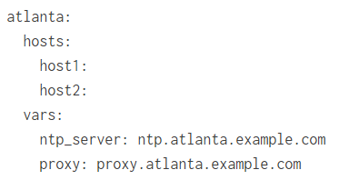
Large inventories
You can use ranges or regexes in inventory definitions, as shown here:
You can also use YAML for describing inventory
[web]
web[01:16].example.com
[web-secure]
web-secure-[a:m].example.com:443

Slide 19
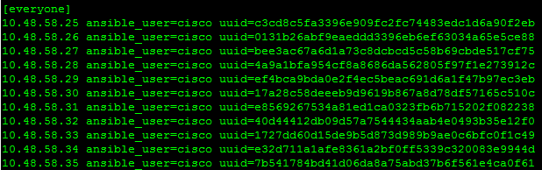
Inventory variables: dynamic substitution
Consider the following ad-hoc command:
ansible -i ./hosts everyone -m shell -a "rm -f /usr/local/tet/sensor_id; echo {{ uuid }} > /usr/local/tet/sensor_id" -become_user=cisco -become_method=sudo –become
Coupled with this inventory file:
For each host entry in group [everyone], Ansible replaces {{ uuid }} with the value from the inventory file
That’s Jinja2 at work – a keystone of Ansible’s philosophy

Slide 20
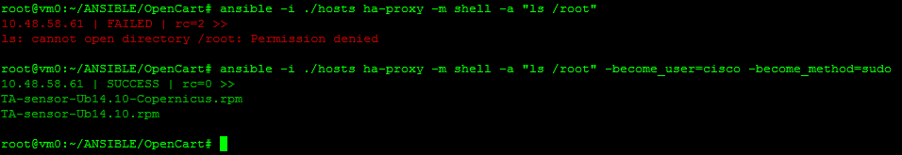
Permissions
Both ad-hoc commands and playbooks can request privilege escalation if necessary
Here’s an example with an ad-hoc command, without and without privilege escalation (user cisco can perform password-less sudo, more later)
In playbooks, it’s done in a very similar fashion – we’ll cover that later

Slide 21
Behavioral parameters
Typically, privileges, usernames, password, connection parameters are specified in the inventory, using variables
There is a series of system variables called behavioral parameters
The most common ones are:
ansible_user
ansible_ssh_pass
ansible_host
why? Imagine your host is defined as foo.example.com. While Ansible server might be able to resolve that, what if the remote system can’t resolve foo.example.com? You can pass an IP address using ansible_host=10.10.10.100 for example
ansible_become (force privilege escalation)
ansible_become_user (which user to escalate as)
ansible_become_method (how to gain privilege escalation; default sudo)

Slide 22
Ansible Playbooks

Slide 23
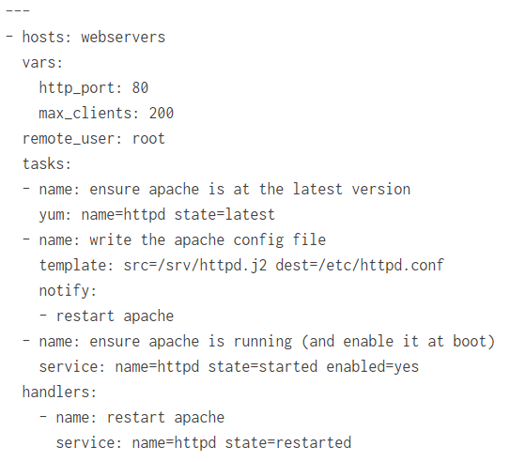
Ansible 101: playbooks
Here’s a simple playbook (don’t worry about its contents right now)
This playbook contains 3 different plays (look for – name) and one handler at the bottom. We’ll cover handlers later (they’re called when a play uses the notify keyword).

Slide 24
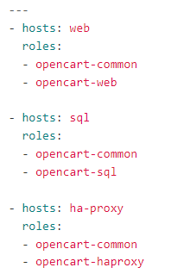
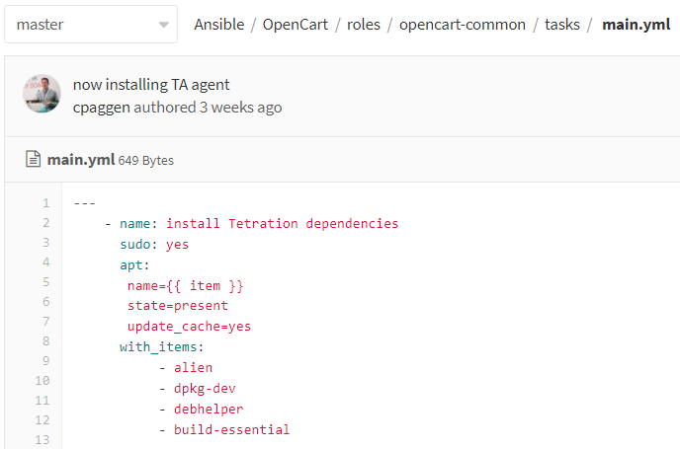
Ansible 101: playbook with roles
And here’s a playbook with different roles:
Each role has a corresponding directory. In that directory, you’ll find at least one tasks/main.yml file.

Slide 25
Ansible installation

Slide 26
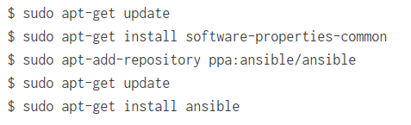
Ansible installation
Installing Ansible is very simple – for most distributions, it’s just a package
Covering all distros in this deck wouldn’t be reasonable
Please visit http://docs.ansible.com/ansible/latest/intro_installation.html
On Ubuntu, it’s as simple as this:
Make sure you get at least version 2.0 (you will if you point to the appropriate package repos)

Slide 27

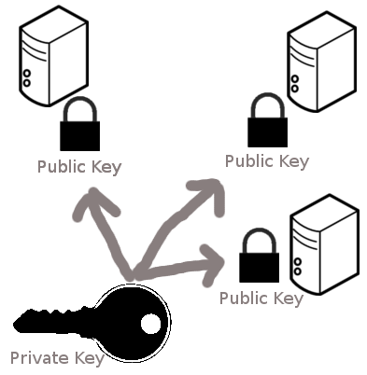

A little bit of sysadmin first
Communications between Linux versions of Ansible and targets uses SSH
You could provide credentials each and every time Ansible executes a command
But you probably don’t want that
Enters password-less SSH
Authenticate using keys rather than via interactive username/password combination
You can think of the public key as the padlock. Suppose you can make thousands of copies of it and distribute them to anyone you please.
The private key opens all those padlocks. You never want to distribute that key, else anybody can open your padlocks.
With Ansible, you generate a key pair on the Ansible server.
You distribute the public key to all target systems (by adding it to authorized_keys in ~/.ssh on the target system)
Using your private key, you can then SSH to the target without being asked for a password.

Slide 28
Come on! Talk technical to me!
OK – so here’s how authentication (we’re not covering encryption) really works:
Client sends an ID for the key pair it would like to authenticate with to the server
Server checks authorized_keys for the account that the client is attempting to log into for that key ID
If public key is found, server generates random number and encrypts it with the public key
Server sends encrypted message back to client
If client has private key, it can decrypt the message, revealing the random number
Client combines decrypted random number with shared session key used for encryption and calculates MD5 hash of this value
Client sends MD5 hash back to server
Server uses same shared session key and the original random number to calculate its own MD5 value. If it matches the client’s, client is authenticated!

Slide 29
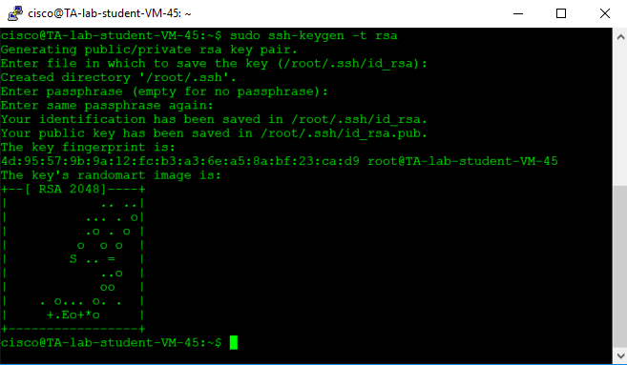
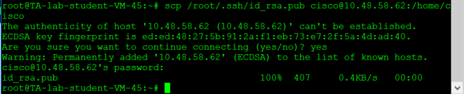
SSH key-based authentication
Example (server-side): generate keypair
Note: you can protect your private key with a password. That’s useful in case someone walks away with your hard drive or computer. For the lab, I don’t care.
Copy public key to target

Slide 30
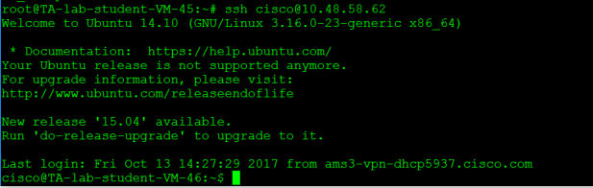
SSH key-based authentication
Client-side: import key in authorized_keys
Now ssh from server to target:

Slide 31
SSH: one more thing
By default, if you’ve never SSHd into a remote system, you don’t have a local copy of that host’s fingerprint in your local known hosts file
You can think of fingerprint as credentials presented to you by the remote system
Most if not all Linux-based systems default to strict host key checking, which means Ansible will fail to SSH into remote systems until you obtain and store a local copy of the remote host’s fingerprint (or key)
You can either SSH once to that remote host and trust the key, or configure your server to disable strict host key checking for the machines you’re automating

Slide 32
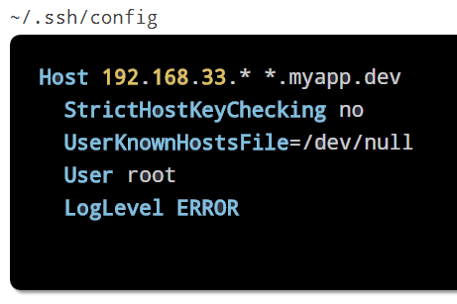
If your server wants you to verify the host key every time …
If you re-init existing targets, or automate new targets, your server is going to ask whether you trust the key – requiring human intervention.
On Ansible server, you can configure SSH to not perform strict host key checks
You can also do this at Ansible’s level only by editing /etc/ansible/ansible.cfg
Or globally in .ssh/config, by range of hosts:
[defaults]
host_key_checking = False
This advice is only good for labs – I wouldn’t do this in production … you’ve been warned.

Slide 33
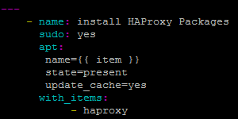
Small detour: is Ansible declarative?
Ansible can be declarative
Declarative means you specify the desired end state of things, you don’t specify how to get to that end state
Example:
Ansible can also be quite imperative:

Slide 34
Small detour: is Ansible idempotent?
You most definitely want your automation software to be idempotent
Idempotency means that making that same call repeatedly produces the same result
For example if a given package has already been installed by the automation software and you run the automation sequence again, the package should not be re-installed and everything reset to defaults.
Running the same sequence again and again shouldn’t leave the system in an unpredictable state.
Think about it .. if you automate your infrastructure with bespoke scripts and the backend doesn’t offer idempotency, your script needs to ensure it’s idempotent.
That’s not exactly trivial!
Ansible is idempotent
Unless you write primarily imperative playbooks.

Slide 35
Setting up your test environment

Slide 36
Setting up a lab environment (heavily recommended)
Set up 2 or 3 Linux VMs (or cloud instances, or Docker Containers, or whatever works for you)
In this document, we’re using either Vagrant+VirtualBox or Docker.
If you’re going to use Docker, here’s a good Dockerfile to start a remote system:
Build a image with docker build –t ansible_client .
Start a container with docker run –d –P --name ansible_target_01 ansible_client
FROM ubuntu:16.04
RUN apt-get update && apt-get install -y openssh-server whois sudo wget python python-pip net-tools
RUN mkdir /var/run/sshd
RUN echo 'root:cisco' | chpasswd
RUN sed -i 's/PermitRootLogin prohibit-password/PermitRootLogin yes/' /etc/ssh/sshd_config
RUN sed 's@session\s*required\s*pam_loginuid.so@session optional pam_loginuid.so@g' -i /etc/pam.d/sshd
ENV NOTVISIBLE "in users profile"
RUN echo "export VISIBLE=now" >> /etc/profile
RUN useradd -m -p $(mkpasswd --hash=SHA-512 cisco) -s /bin/bash -d /home/cisco cisco
RUN usermod -aG sudo cisco
RUN echo "cisco ALL=(ALL) NOPASSWD: ALL" >> /etc/sudoers
RUN sed -i '/Defaults\tenv_reset/d' /etc/sudoers
RUN mkdir /home/cisco/.ssh
RUN chown -R cisco:cisco /home/cisco/
EXPOSE 22
CMD ["/usr/sbin/sshd", "-D"]

Slide 37
Other ways to run a nice little lab
If you’re not too familiar with Docker, Vagrant + VirtualBox is a good option
If you don’t know what Vagrant is, see next slide
Download vagrant from vagrantup.com and virtualbox from virtualbox.org
Grab v5.1 if you’re on Windows – Vagrant doesn’t like v5.2
Run ‘vagrant plugin install virtualbox’
Create an empty directory on your local system and type “vagrant init”
Using your favorite text editor, edit the Vagrantfile that was just created
In there, define 2 or 3 boxes (vagrantcloud.com) you’d like to start
Pick Ubuntu/trusty64 for the Ansible server and your target systems
Feel free to create three VMs in total (one Ansible server, one for web, one for SQL)

Slide 38
Vagrant?
It’s a VM provisioning tool that can control a variety of hypervisors or VM managers (VirtualBox being one of them)
You define what your VMs should look like in a config file
For instance, VM should have two NICs, these packages installed, that IP address on that network, this name, etc.
Vagrantcloud contains a wide range of ready-to-use images for VMs
Those are called boxes
Inside the Vagrantfile, you specify which box the VM should boot from
When you’re done, you “vagrant up” the directory
This brings up your environment and Vagrant handles the nitty-gritty details
It’s a huge timesaver that lets you build and rebuild the same environments again and again

Slide 39
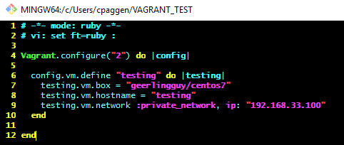
Vagrant: a very simple Vagrantfile
Inside a directory, we type “vagrant init”. This creates a long Vagrantfile.
Edit Vagrantfile, delete everything except for the top 4 lines and the final end statement
Make your file look like this
Then, type “vagrant up” and watch. The image is pulled down for you, Vagrant orchestrates VirtualBox and within minutes, your VM is up and running!

Slide 40
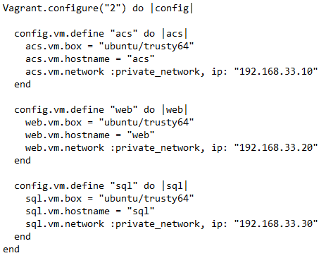
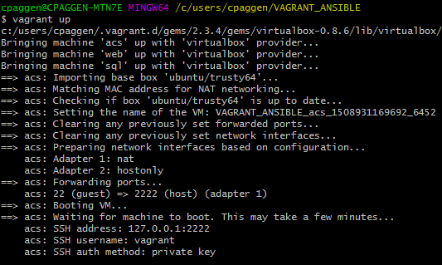
Sample Vagrantfile for 3 VMs
acs as in “Ansible Control Server”
You’re ready to “vagrant up” !

Slide 41
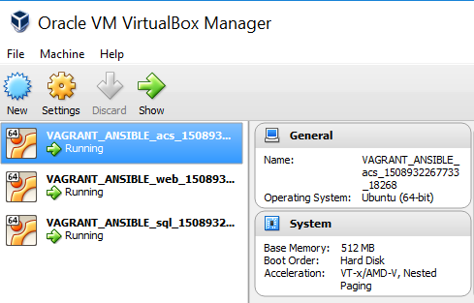
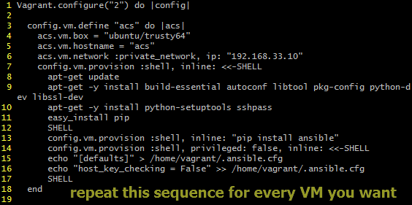
Vagrant and VirtualBox example
This Vagrantfile provisions a VM and ensures packages are downloaded and installed when the VM is booted. Just copy/paste this block as many times as VMs are required (and change the |acs| name and references)

Slide 42
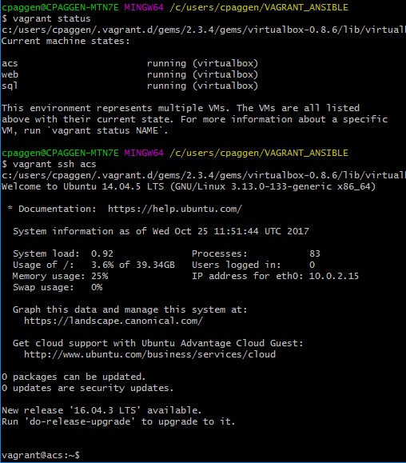
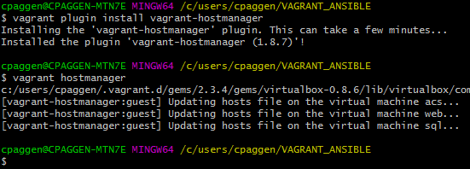
SSH into a VM provisioned by Vagrant
It’s as simple as this:
Vagrant can update your /etc/hosts file:

Slide 43
Test your enviroment
You should have some sort of test environment by now
Either with VMs provisioned by Vagrant, or manually, or in the cloud, or with Docker, etc.
Test SSH between your Ansible server and your VMs
For now, use passwords using the host variables ansible_user and ansible_ssh_pass
In production, or in large environment, you’ll want to use key-based authentication instead of passwords
That’s what all cloud providers do by the way – you never get a username/password to your cloud instance. You’re expected to use keys.
The next section covers how this works

Slide 44
SSH tips and tricks

Slide 45
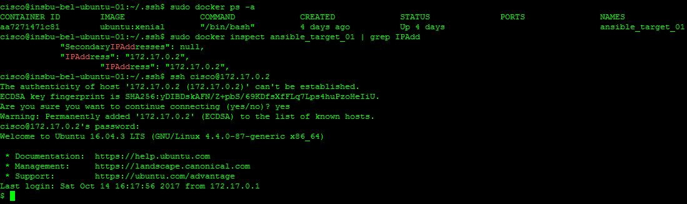
SSH: key-based authentication
Using our test environment (host = server; container = target), let’s first SSH to the remote system
A password is required, as expected

Slide 46
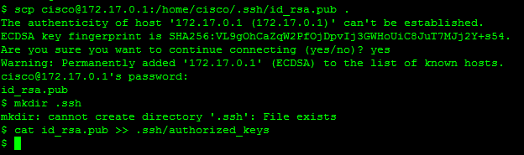
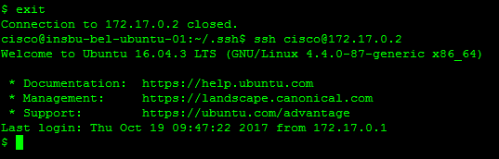
Importing the key
On the server, generate a RSA keypair (ssh-keygen -t rsa)
Next, copy the key from the server to the client and add it to .ssh/authorized_keys
Log out and SSH back in. No password required this time:

Slide 47
Passwordless sudoing
Installing packages and modifying config files usually requires admin/root privileges
While you can have Ansible plays ask for a root password, it isn’t very practical
Suggestion: allow your Ansible user to execute elevated-privilege commands without being asked for a root password
This is achieved by:
Ensuring the Ansible user is in the sudoers list (see the Dockerfile a few slides back)
Granting password-less sudo rights to that user
While root on the target machine, simply do this for user ‘cisco’
echo "cisco ALL=(ALL) NOPASSWD: ALL" >> /etc/sudoers

Slide 48
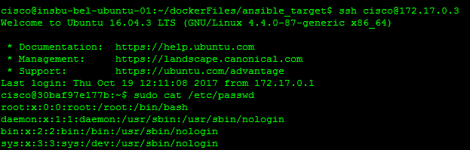
Passwordless sudoing: lab example
Make sure your target VM allows your user to get root privileges without a password
This will make your playbooks simpler and much less interactive
Note: only do this if you know what you’re doing – some security-minded folks will frown at the thought of blindly granting sudo privileges to a user.

Slide 49
Running ad-hoc commands

Slide 50
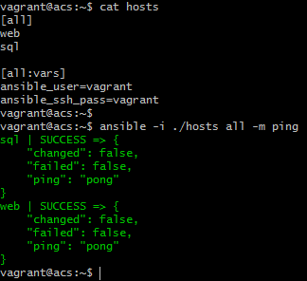
Creating a host file
Assuming your environment consists of at least one Ansible server and one or two target systems, create a simple hosts file such as this one
Then, run the ping module.
When you entered “-m ping”, you invoked the ping module
Most modules accept parameters through the –a flag
Notice the all:vars section, don’t forget to include it to your inventory

Slide 51
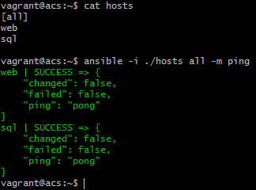
Without passwords this time
Assuming you verified key-based SSH functions properly in your environment, delete the [all:vars] section from the inventory file and invoke the ping module again:
You may have noticed we’re using reserved group [all] – it doesn’t matter, Ansible is forgiving
Success! Key-based authentication has taken over.

Slide 52
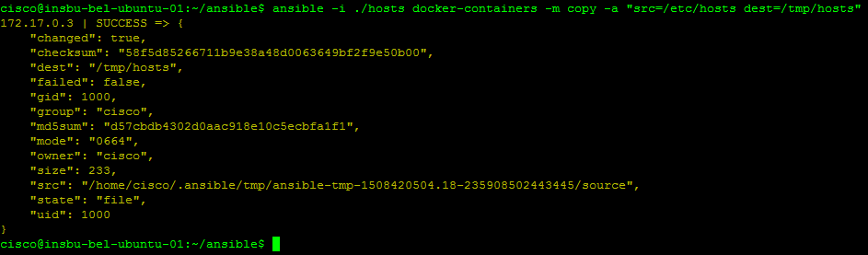
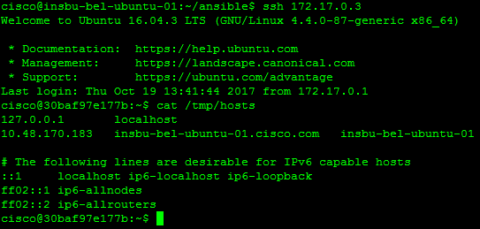
More ad-hoc commands
Make sure you’ve run a few ad-hoc commands and understand how they work
There are multiple modules for ad-hoc commands. You can copy files to targets using the copy module for instance:

Slide 53
Ansible modules
Modules (all of them; 465+ as of Oct 2017) ship with Ansible automatically
You don’t need to pull down modules
Modules are used inside plays, playbooks and ad-hoc commands
Our ad-hoc commands used a few modules so far (command, copy)
You can write your own modules
Some modules are deprecated; other modules are core
ansible-doc -l (as in Larry) lists all modules on your system
ansible-doc <module> displays off-line help
ansible-doc –s <module> gives you ready-to-use snippets

Slide 54
Very frequent modules
Copy (take local file, pushes to target)
Fetch (fetches file from remote system, verifies integrity)
Service (manages daemons)
Yum
Apt
Shell (executes in proper remote shell; not just in remote Python script)
Setup (collect facts; “tell me which interfaces are present on my systems”)
We’ll come back to facts later in this deck

Slide 55
A few ad-hoc commands
"
ansible webservers -m copy -a "src=/etc/hosts dest=/tmp/hosts”
ansible webservers -m yum -a "name=acme state=present"
ansible all -m user -a "name=foo state=absent"
ansible webservers -m service -a "name=httpd state=started"
Check out the online docs and use the ansible-doc –l command to explore other modules

Slide 56
Back to SSH for a second …

Slide 57
Again SSH?? What’s the problem this time?
It’s about distributing the server’s public key
For a lab, no problem – we can scp the public key to our targets one by one
For sizeable lab deployments or prod environments, that’s not viable
We need a way to distribute the server’s public key to remote systems
That’s what the next slides focus on
Feel free to skip if you’re just going to run a small-size lab environment

Slide 58
Ansible chicken-and-egg problem
We know targets should allow password-less SSH and sudo for Ansible user
But .. how do you get Ansible server’s public SSH key into targets before Ansible can take over the configuration of those targets?
A few ways:
Place public key on web server, boot targets with PXE-boot and pull down key via auto-run script (or create a VM template which already has the key installed)
Run one-time Ansible playbook that asks for target’s credentials and creates new user + requirements for password-less SSH/sudo
With Docker, you can ADD/COPY the key, or use --build-arg key=“$(cat ~/.ssh/id_rsa.pub)”
We prefer option 1 (essentially what all cloud providers do)
For option 2, see https://github.com/jedelman8/server-build-ansible/blob/master/server_one_time_run.yml (run playbook with --ask-sudo-pass -k), see next-slides

Slide 59
Automatically importing SSH public key in targets
Ensure ansible version >= 2.0 on server (apt-add-repository -y ppa:ansible/ansible)
Generate RSA ssh key as root, put public key on a web-server the target can access
Boot a target VM via PXE, make PXE run script that imports public key in VM
Enable VM-user to perform password-less sudo
For example, on PXE server append this to kickstart file for Ubuntu:
Inside ubutu-plain.sh, we do this:
# cpaggen
d-i preseed/late_command string in-target mkdir -p /home/cisco/scripts; \
in-target wget -O /home/cisco/scripts/cpaggen-install.sh \
"http://10.48.58.55/KICKSTARTS/ubuntu-plain.sh"; \
in-target chmod +x /home/cisco/scripts/cpaggen-install.sh; \
in-target /home/cisco/scripts/cpaggen-install.sh
wget http://10.48.58.55/KICKSTARTS/ansible-public-key.pub -O /home/cisco/ansible-public-key.pub
mkdir -p /home/cisco/.ssh
cat /home/cisco/ansible-public-key.pub >> /home/cisco/.ssh/authorized_keys
echo "cisco ALL=(ALL) NOPASSWD: ALL" >> /etc/sudoers

Slide 60
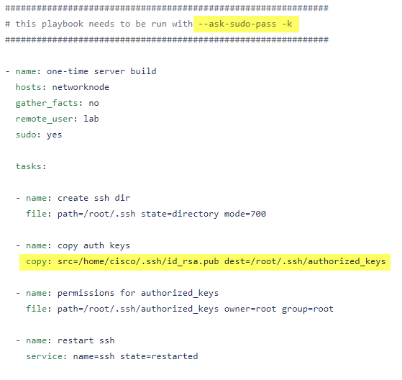
Importing SSH key into targets using Ansible itself

Slide 61
Importing the server’s public key in Docker images
This is just one option: you can pass the key at image build time using build-arg. Using --squash merges the layers and removes the key from the history. Not uber-safe, but works well in labs:
docker build -t example --build-arg --build-arg ssh_pub_key="$(cat ~/.ssh/id_rsa.pub)" --squash .
FROM <your_base_image>
ARG ssh_pub_key
RUN apt-get update && apt-get install -y git openssh-server
etc.
You can do something similar with Vagrant using the :shell directive.

Slide 62
I can’t be bothered!
Ansible will work without all that, as we saw before
If you don’t mind specifying ansible_user and ansible_ssh_pass for your hosts, that’s fine
You won’t want to store credentials in the clear in your inventory files though
Ansible provides a mechanism called the Ansible Vault to securely store credentials
This is beyond the scope of this deck, but at least you know it exists

Slide 63
Playbooks

Slide 64
What are playbooks for?
So far, we ran a few ad-hoc commands
Those are convenient for running single commands across inventory items
What if you want to perform multiple operations on a remote system?
What if you’d like to automate multiple remote systems?
What if you’d like this process to be repeatable?
What if you’d like to share your work with others?
That’s what playbooks are for
They contain sequence of instructions (plays) that apply to inventory items

Slide 65
Playbooks are written in YAML. A bit of syntax first.
Before we start, here’s a tiny bit of YAML syntax you need to know
Three dashes must exist at the beginning of every playbook
Respect a consistent indentation throughout the playbook
---
- name: webfrontend
hosts: web
tasks:
- name: install nginx
yum: name=nginx state=present
- name: ensure nginx is running
service: name=nginx state=started enabled=yes
Attributes for modules (yum here) use the att=value syntax

Slide 66
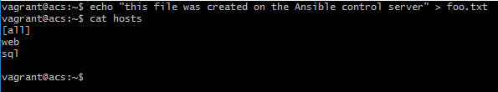
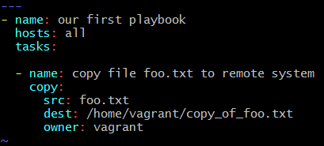
Our first super-simple playbook
Let’s copy local file ‘foo’ to all our systems
First, create file foo.txt and check your inventory:
Then, create this playbook:

Slide 67
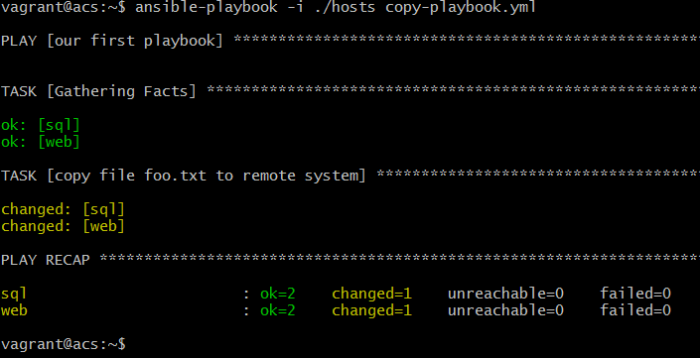
Run the playbook!
This time, use the ansible-playbook command

Slide 68
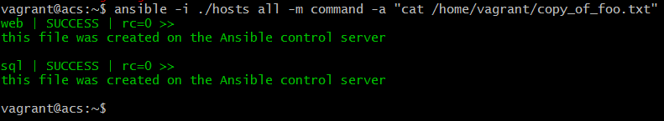
Challenge
That seems to have worked.
Challenge: using an ad-hoc command, display the contents of the file on your remote systems
Don’t look at the bottom of this slide just yet, the solution is displayed ..

Slide 69
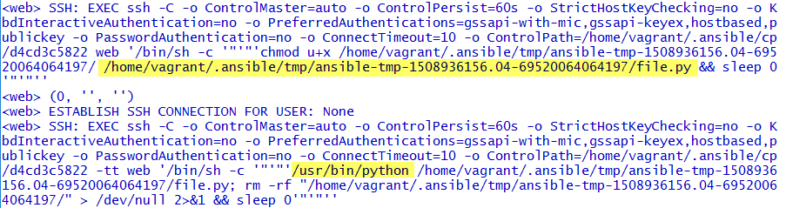
Debugging the playbook
Now run the playbook again using –vvv this time
Inspect the debugging for the copy task in particular
See the SSH connection pushing a Python script called ‘file.py’ on remote systems?

Slide 70
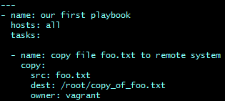
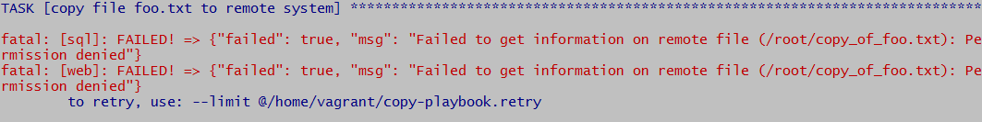
Now let’s try something that won’t work
Now, modify the playbook so it copies the file to the /root directory of remote systems
Run the playbook again

Slide 71
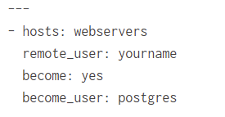
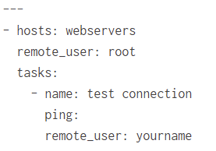
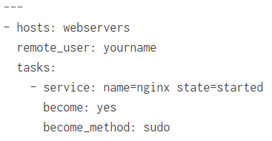
Let’s cover privileges for a second
When you log in as ‘user’ on the Ansible server, by default all plays run as ‘user’ on target systems
It’s possible to specify a different login user, and a different sudo/root user either per playbook, per play, or per task
You’ll often come across two syntaxes (pre 1.9 and post 1.9) to obtain privilege escalation
sudo: yes combined with ansible_user in the inventory or play
become: yes in conjunction with become_user (root is default) and become_method (sudo default)
The ‘become’ method is preferred
Ansible warns you if you use sudo as it will likely be deprecated in the future

Slide 72
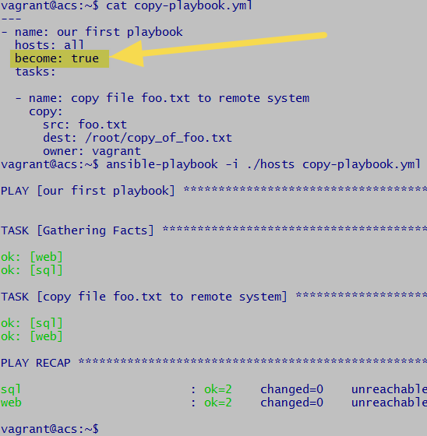
Let’s fix our playbook
If you did set up password-less sudo, fixing our playbook is as simple as this:
If you don’t have password-less sudo, how would you fix this playbook?
Hint: ansible_become_pass could help ..

Slide 73
OK – a bit more advanced now
Let’s now deploy software packages with a playbook
Let’s also create an index.html file and use variable substitution to customize it!

Slide 74
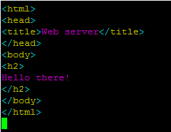
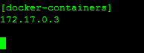
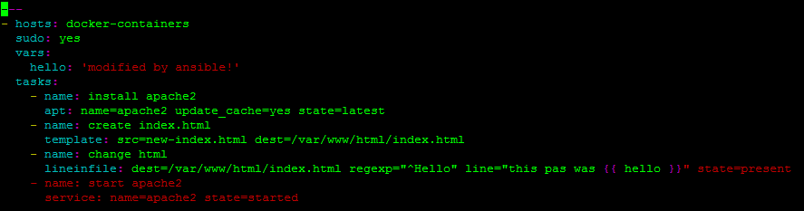
Basic playbook for deploying and customizing apache2
In local server directory, create hosts file and new-index.html file
Create playbook (we’re using the old sudo syntax – shame!)

Slide 75
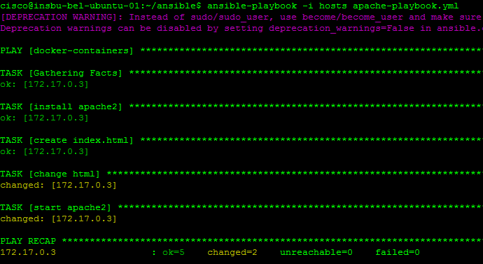
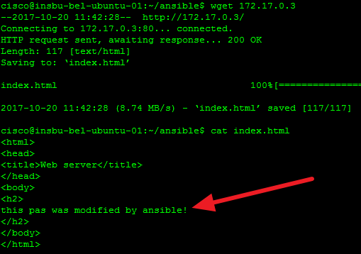
Run playbook
Run the playbook as follows:

Slide 76
What have we done?
We told Ansible to install apache2, then copy a server-side file called new-index.html to the target under /var/www/html/index.html
We then told Ansible to modify a line inside that file using a regular expression
If line starts with “hello” then replace it with “this page was {{ hello }}”
Ansible substituted {{ hello }} with “modified by ansible!”
hello is declared as a variable inside the playbook directly
What if we wanted to this without regular expressions? Next slides

Slide 77
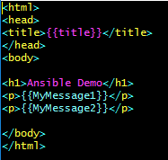


Better templating (no regex this time)
You can directly create variable placeholders in template files (html, etc.)
Then, when invoking an operation such as copy from the template to a destination, automatic variable substitution happens
Don’t worry about port 8080.
We’re just playing with VirtualBox’
port redirection feature. Apache is listening to port 80 on the remote system.

Slide 78


Small detour: gathering facts – what is this?
You may have noticed Ansible runs a role by default called “gathering facts”
Ansible collects tons of information about targets, information you can use as variables if required
Try this ad-hoc command with the setup module (gathers facts):

Slide 79

Gathering facts: what for
You can use those facts as dynamic variables in your plays
Suppose you need to know the IP of the remote system Ansible is currently processing
Variables for the host currently being processed are accessible via dictionary hostvars
Use the debug task to dump a variable on the screen and see how this works

Slide 80

Ansible handlers
If you make a change that requires to restart a process, create a handler in the playbook as follows. Handlers are smart enough to bounce the service just once, even if called by multiple tasks.
Handlers are called by name, as shown here

Slide 81

Playbooks with multiple inventory groups
You can create multiple group plays inside one playbook, like so:

Slide 82
Playbooks with roles

Slide 83
Creating playbooks with roles
The playbooks we created so far are simple playbooks with a list of plays and variables directly in one YAML file
Playbooks that automate multiple systems typically break down the plays by role
Systems in the inventory are assigned roles, and each role has its own templates, files, handlers, variables and plays
The main playbook is therefore very simple: it assigns roles to groups, and that’s it
Each role contains a specific directory with at least one tasks/main.yml file
This is quite common in community playbooks, so let’s get used to that structure (see next slide)

Slide 84

A playbook with roles
Your playbook becomes as simple as:
You need to create a corresponding directory structure that tell Ansible where to find a given role’s plays and variables

Slide 85

Common directory structure
To keep a simple master playbook, break down individual roles into directories
Inside each role directory, have at least one tasks/main.yml playbook
Variables defined in filename all in directory group_vars apply to all roles
Roles can have their own variables too (host_vars take precedences, followed by group_vars/<group>, followed by group_vars/all)

Slide 86
What do I put in those role directories?
The following directories are very frequent inside role directories
tasks: main list of tasks for this role
handlers: handlers for this role (can be called outside this role too)
defaults: default variables for this role
vars: other variables for this role
files: files which can be deployed via this role
templates: templates whihch can be deployed via this role
meta: metadata for this role

Slide 87

Example: deploying a 4-VM Opencart app
Take a look at https://wwwin-gitlab-sjc.cisco.com/cpaggen/Ansible/blob/master/OpenCart/deploy-opencart.yml
We have three groups of hosts, each with two roles applied to them for a total of 4 unique roles.

Slide 88

Directory structure
Inside our roles directory, we find these sub-directories:
Each sub-directory must contain at least a tasks directory in which there must be a main.yml file

Slide 89

Let’s explore a role
This is roles/opencart-common/tasks/main.yml
This file comes from the roles/opencart-common/templates directory

Slide 90

Top-level common variables
In the top directory, where you main playbook with all the roles is, it’s common to find a group_vars directory containing files with group variables
See https://wwwin-gitlab-sjc.cisco.com/cpaggen/Ansible/tree/master/OpenCart/group_vars
File all contains variables applicable and accessible to each and every role in the playbook (all is a reserved group name which includes all hosts)
In our example, we’re deploying a 4-VM Opencart web application. We need to tell HA-Proxy about the IP of the 2 web servers we want to load balance. We also want to tell the web servers about the SQL database. group_vars/all looks like this:
As you browse the Git repo, you’ll see templates referring to those variables – see next slide for an example.

Slide 91


Group variables inside role templates
Here’s an example where a role is referring to group_vars/all: https://wwwin-gitlab-sjc.cisco.com/cpaggen/Ansible/blob/master/OpenCart/roles/opencart-haproxy/templates/front-end.j2
At the bottom of the file, you’ll see variables between curly braces:
Directory group_vars can contain variable files specific to roles. Just name the file after the role in that case.
This is how a play in the haproxy role refers to this template:

Slide 92

Passing variables when invoking ansible
You can even do something like this:

Slide 93

Group variables and host variables
Consider this directory structure
If you define for instance variable username=cisco_db inside group_vars/db AND username=cisco_all in groups_vars/all and run a playbook that calls variable username, group_vars/db takes precedence.
Likewise, if you define the same variable in host_vars/web1 and target web1 in a play, this variable takes precedence overs groups_vars/db and groups_vars/all

Slide 94

Checking playbook syntax before execution, and seeing who’s affected
You can check the syntax using the --syntax-check option
To see which hosts will be affected by the playbook, do this

Slide 95
Sample playbooks
Have a look at https://github.com/ansible/ansible-examples for simple playbooks using the directory structure covered in previous slides
Get familiar with commonly used modules and try your own playbooks with roles

Slide 96
More advanced features

Slide 97


Using the output of a task in another task
You can capture the output of a task with the register keyword, as follows:

Slide 98

Using tags
You can tag playbooks and/or tasks
You can limit the execution scope of playbooks using the --tags keyword:
Note: a special tag called always exists. Tasks or roles tagged with always run all the time, unless explicitly skipped!

Slide 99

Prompt user for input

Slide 100

Conditional tasks
Gather facts for this to run:

Slide 101

Using include in playbooks

Slide 102



Group patterns

Slide 103
ACI integration

Slide 104
ACI with Ansible
Ansible 2.4 ships with dozens of tasks to configure ACI
Two modes:
classic playbooks with roles (what we’ve been doing so far in this deck)
Galaxy playbooks with very detailed inventories and fairly static playbooks
https://galaxy.ansible.com/datacenter/aci-model/
ansible-galaxy install datacenter.aci-model or git clone the repo (https://github.com/datacenter/ansible-role-aci-model)
We’re going to cover the classic-style modules first as those match exactly the model we’ve been going through in this deck

Slide 105

What can Ansible do for your ACI fabric?

Slide 106
Configure a VRF using ‘aci_vrf’ module
Creates a VRF called “MyVRF” inside “MyTenant”
Deletes a VRF called “MyVRF” inside “MyTenant”
- name: create a new VRF
aci_vrf:
hostname: "{{ inventory_hostname }}"
username: "{{ user }}"
password: "{{ pass }}"
validate_certs: False
state: present
vrf: ”MyVRF"
tenant: ”MyTenant"
descr: "Ansible created VRF"
policy_control_preference: enforced
policy_control_direction: ingress
- name: create a new VRF
aci_vrf:
hostname: "{{ inventory_hostname }}"
username: "{{ user }}"
password: "{{ pass }}"
validate_certs: False
state: absent
vrf: ”MyVRF"
tenant: ”MyTenant"
descr: "Ansible created VRF"
policy_control_preference: enforced
policy_control_direction: ingress

Slide 107
Configure a BD using ‘aci_bd’ module
Creates a BD called “MyBD” inside “MyTenant”
Deletes a BD called “MyBD” inside “MyTenant”
- name: create bridge domain
aci_bd:
hostname: "{{ inventory_hostname }}”
username: "{{ user }}"
password: "{{ pass }}"
validate_certs: False
state: present
tenant: “MyTenant”
bd: ”MyBD"
vrf: “MyVRF”
enable_routing: yes
arp_flooding: no
l2_unknown_unicast: flood
- name: create bridge domain
aci_bd:
hostname: "{{ inventory_hostname }}”
username: "{{ user }}"
password: "{{ pass }}"
validate_certs: False
state: absent
tenant: “MyTenant”
bd: ”MyBD"
vrf: “MyVRF”
enable_routing: yes
arp_flooding: no
l2_unknown_unicast: flood

Slide 108
Configure an EPG and add contracts using ‘aci_epg’ and ‘aci_epg_to_contract’ modules
Creates an EPG called “Web” inside “MyTenant”
Adds consumed contract to EPG Web
- name: create EPG for Web-Tier
aci_epg:
hostname: "{{ inventory_hostname }}"
username: "{{ user }}"
password: "{{ pass }}"
validate_certs: False
state: present
tenant: “MyTenant“
epg: "Web“
ap: “MyApp“
bd: “MyBD“
- name: contract for Web-Tier to internet
aci_epg_to_contract:
hostname: "{{ inventory_hostname }}"
username: "{{ user }}"
password: "{{ pass }}"
validate_certs: False
state: present
tenant: “MyTenant“
epg: "Web“
ap: “MyApp“
contract_type: consumer
contract: “Allow-Internet“

Slide 109


Using the (new) Ansible Galaxy roles for ACI
This role takes a different approach than what we’ve seen so far
It strives to keep roles super simple, while pushing the configuration details to the inventory
Let’s take a look .. Install the Galaxy role first
Let’s examine the directory where it installed:

Slide 110


Let’s look at the samples
The inventory is quite different from what we’ve seen so far
The philosophy here is that you describe all the intent in the inventory, while keeping the playbooks virtually similar for all environments (meaning my playbook will likely work on your fabric)
You can literally setup ACI from scratch using this Ansible role

Slide 111

What about the playbook?
Here’s the sample:
And that’s it! As we wrote previously, all config data resides in the inventory
Behind the scenes, this role uses the REST API of APIC

Slide 112
Let’s test this
fabric01:
hosts:
apic1:
apic_host: 10.48.58.5
apic_username: sdn
apic_password: cisco
vars:
apic_use_proxy: no
apic_validate_certs: no
aci_topology:
tenant:
- name: AnsibleGalaxyExample
description: Example
app:
- name: Billing
epg:
- name: web
bd: web_bd
contract:
- name: internet
type: consumer
- name: web_app
type: consumer
- name: app
bd: app_bd
contract:
- name: web_app
type: provider
bd:
- name: app_bd
subnet:
- name: 10.10.10.1
mask: 24
scope: private
vrf: Example99
- name: web_bd
subnet:
- name: 20.20.20.1
mask: 24
scope: public
vrf: Example99
vrf:
- name: Example99
contract:
- name: internet
scope: tenant
subject:
- name: internet
filter: default
- name: web_app
scope: tenant
subject:
- name: web_app
filter: default
Create a simple inventory file first
Pay attention to the indentation!
As you can see, you need to respect ACI’s object hierarchy
Create this inventory file in the directory where you installed the ACI Galaxy role by the way

Slide 113
Use this playbook
- hosts: apic1
gather_facts: no
roles:
- role: datacenter.aci-model
aci_model_data: '{{ aci_topology }}'
The playbook is very simple:
Run it as follows:
vagrant@acs:~/.ansible/roles/datacenter.aci-model$ ansible-playbook -i ./my-aci-inventory.yml my-aci-playbook.yml -v
Using /home/vagrant/.ansible/roles/datacenter.aci-model/ansible.cfg as config file
PLAY [apic1] *************************************************************************************************************************************
TASK [datacenter.aci-model : include_tasks] *************************************************************************************************************************************
included: /home/vagrant/.ansible/roles/datacenter.aci-model/tasks/main-json.yml for apic1
TASK [datacenter.aci-model : Create tenants] *************************************************************************************************************************************
ok: [apic1 -> localhost] => (item={u'tenant_name': u'AnsibleGalaxyExample', u'tenant_description': u'Example'}) => {"changed": false, "config": {}, "existing": [{"fvTenant": {"attributes": {"descr": "Example", "dn": "un
i/tn-AnsibleGalaxyExample", "name": "AnsibleGalaxyExample", "nameAlias": "", "ownerKey": "", "ownerTag": ""}}}], "failed": false, "filter_string": "?rsp-prop-include=config-only", "item": {"tenant_description": "Example
", "tenant_name": "AnsibleGalaxyExample"}, "method": "GET", "proposed": {"fvTenant": {"attributes": {"descr": "Example", "name": "AnsibleGalaxyExample"}}}, "response": "OK (185 bytes)", "status": 200, "url": "https://10
.48.58.5/api/mo/uni/tn-[AnsibleGalaxyExample].json"}
TASK [datacenter.aci-model : Create VRFs] ************************************************************************************************

Slide 114

Checking
You’ll notice the role just runs unconditionally through a series of plays
If your inventory does not include L3out for instance, it just skips the play
Check your ACI fabric now

Slide 115
A little different, right?
Feel free to use either the Galaxy role, or the more classic Ansible ACI modules
Both eventually do the same thing, albeit with a different philosophy
The Galaxy role lends itself well to large-scale deployments, or automating an entire fabric from zero – including the configuration of VPCs, AAEP, etc.
The classic modules are easier to grasp at first, but aren’t as fully-featured as the Galaxy role
Up to you to decide which one to use!

Slide 116
ACI integration: raw XML/JSON

Slide 117
What if you already have a collection of JSON/XML snippets?
It’s quite possible you’ve already garnered a decent collection of JSON or XML snippets you directly use with APIC’s REST API, through POSTMAN for example
It’s also possible you’d like to use JSON snippets produced by APIC’s API inspector
This is possible with Ansible 2.4 and its ACI REST module
https://docs.ansible.com/ansible/2.4/aci_rest_module.html
That’s essentially what the ACI Galaxy role we just covered relies on
The way it works is quite straightforward: you pass the raw JSON or XML content to the Ansible module – examples follow

Slide 118
ACI REST API module for Ansible
Using this inventory file
And the following playbook
root@vm0:~/ANSIBLE/ACI# cat aci-hosts
insbu-bel-apic-1.cisco.com ansible_ssh_user=sdn ansible_ssh_pass=cisco aci_hostname=10.48.58.5 aci_username=sdn aci_password=cisco
root@vm0:~/ANSIBLE/ACI#
root@vm0:~/ANSIBLE/ACI# cat aci_rest_api.yml
---
- hosts: insbu-bel-apic-1.cisco.com
vars:
tasks:
- name: Add a tenant using a JSON string
aci_rest:
hostname: '{{ inventory_hostname }}'
username: '{{ aci_username }}'
password: '{{ aci_password }}'
validate_certs: no
path: /api/mo/uni/tn-AnsibleRest.json
method: post
content: |
{
"fvTenant": {
"attributes": {
"name": “AnsibleRest",
"descr": “REST demo"
}
}
}
delegate_to: localhost

Slide 119

ACI REST API module for Ansible
Run the playbook, and you have a brand new tenant:
OK – what’s this “delegate_to” option in the playbook?
It tells Ansible to have the host specified after delegate_to run the command
In this case, it’s localhost (the Ansible server) directly running the HTTP/HTTPS request

Slide 120

Delegate_to
If you tcpdump communications between the Ansible server and APIC, you’ll see that it’s indeed the Ansible server directly talking REST to APIC
Ansible server is 10.48.82.67, APIC is 10.48.58.4:

Slide 121
More examples
You can GET, POST and DELETE using this module
You’re not limited to JSON, you can also use XML
You can even use YAML and let the module translate that for you
It’s possible to turn off SSL by using “use_ssl: no”
Variable substitution works too here (quite convenient for mass operations)
See the official doc for examples

Slide 122
ACI integration: bonus

Slide 123


Getting really fancy now
You can use Ansible to parse JSON output

Slide 124
Why would we do something like that?
You probably shouldn’t
This just shows how powerful Ansible can be!

Slide 125
Wrapping up

Slide 126
We’re done!
Our Ansible 101 introduction is complete
Ansible’s value proposition: automate most DC assets with a minimal learning curve
Due to its push-based agent-less architecture and simple syntax, it’s arguably significantly easier to adopt than other similar tools (Puppet, Chef, etc.)
Practice again and again using your test environment
Send any comments or suggestions about this deck to the author: cpaggen@cisco.com

